Slide 1
8 years in the lab
06.18.13

Slide 2
Outlines
Job hunt
My future lab

Slide 3
How I found a job
Before:
www.career.ucsf.edu
Have a paper “accepted”

Slide 4
How I found a job
Before:
www.career.ucsf.edu

Slide 5
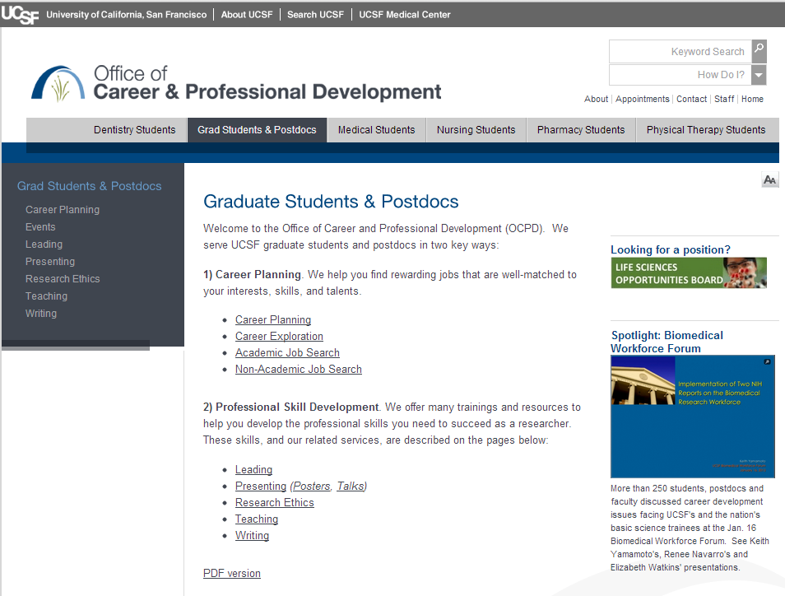
Office of Career and Professional Development

Slide 6
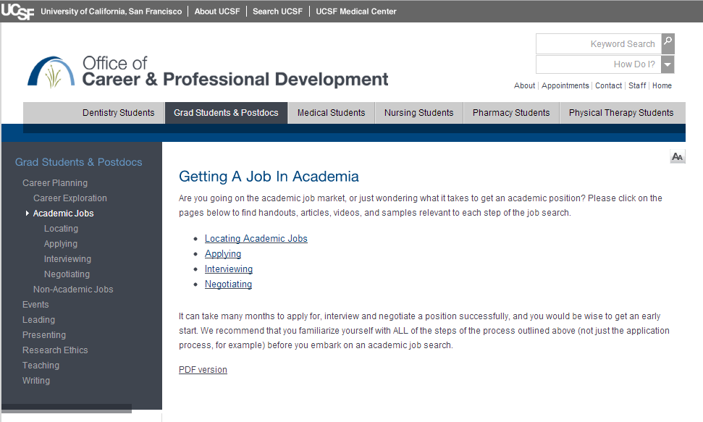
Office of Career and Professional Development

Slide 7
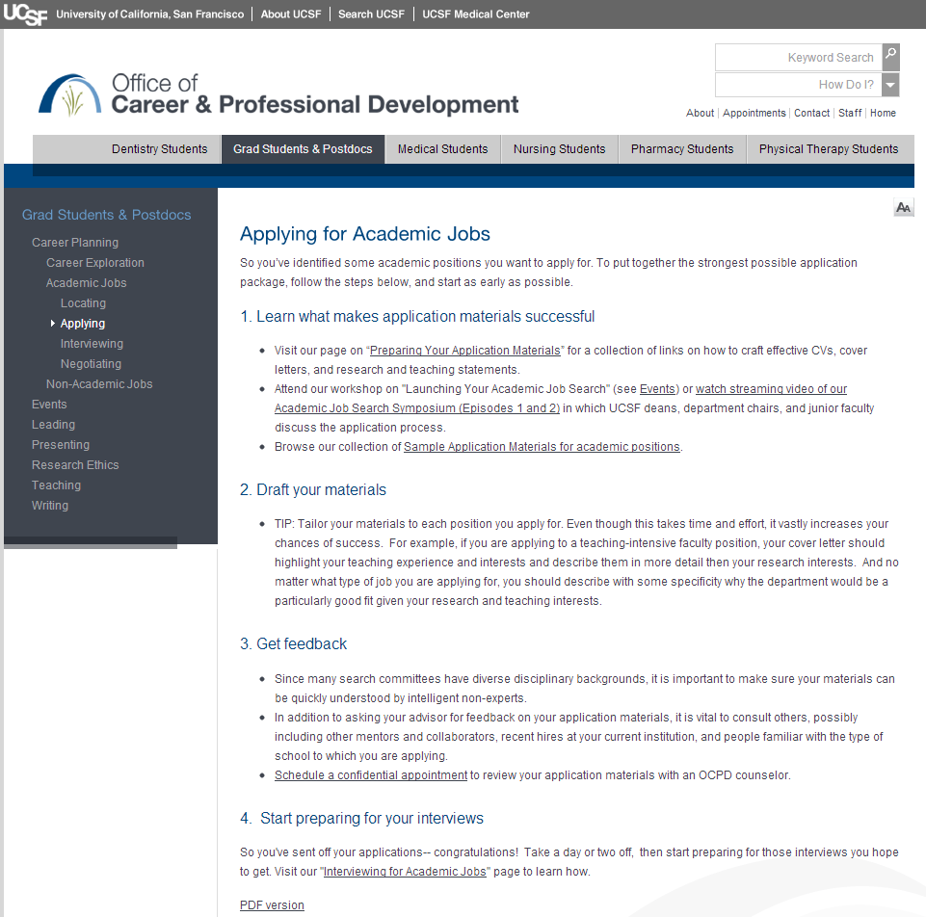
Office of Career and Professional Development

Slide 8
Publication record
Have a paper “accepted”
A small-molecule scaffold induces autophagy in primary neurons and protects against toxicity in a Huntington disease model. Tsvetkov AS. et al. Proc Natl Acad Sci U S A. 2010 Sep 28;107(39):16982-7
Cytoplasmic retention of polyglutamine-expanded androgen receptor ameliorates disease via autophagy in a mouse model of spinal and bulbar muscular atrophy. Montie HL, Cho MS, Holder L, Liu Y, Tsvetkov AS, Finkbeiner S, Merry DE. Hum Mol Genet. 2009 Jun 1;18(11):1937-50
Single neuron ubiquitin-proteasome dynamics accompanying inclusion body formation in huntington disease. Mitra S, Tsvetkov AS, Finkbeiner S. J Biol Chem. 2009 Feb 13;284(7):4398-403
Protein turnover differences between neurons and other cells. Tsvetkov AS, Mitra S, Finkbeiner S. Autophagy July 2009; 5:5, 1-3; 1

Slide 9
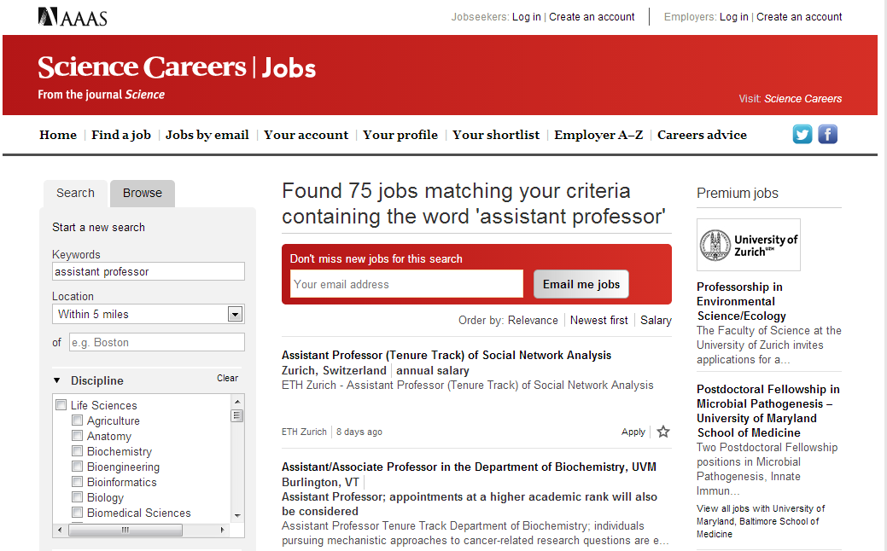
Application

Slide 10
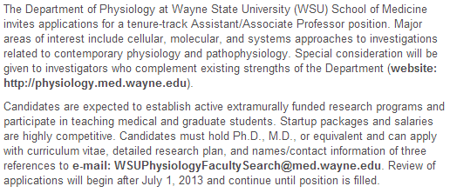
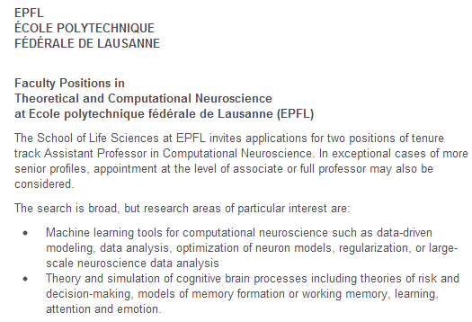
Application: three types of ads

Slide 11
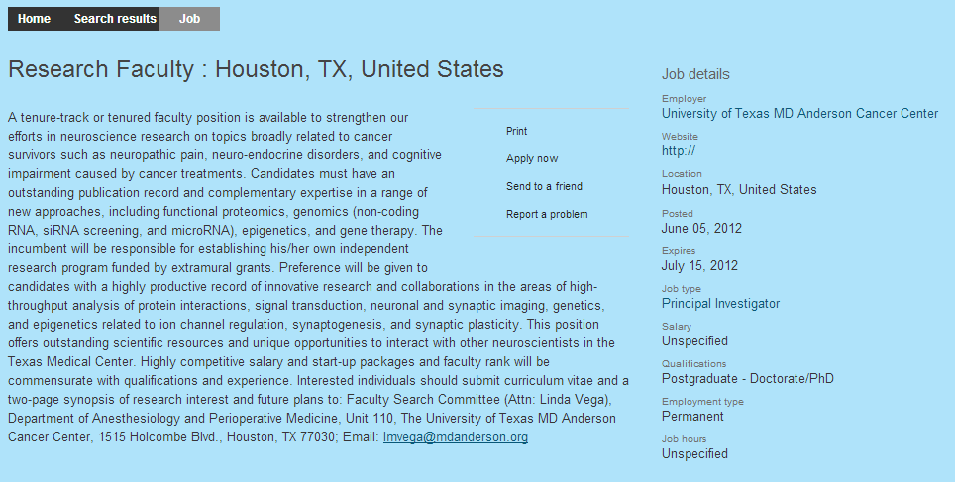
"Thank you for applying to the MD Anderson. We received an overwhelming response and already collected more than 500 applications. Your application will be considered if a candidate is not selected from the first batch."

Slide 12
Application documents
Cover letter (1 page)
Research Statement (2-3 pages)
CV
(Teaching Statement)
(Recommendation letters)

Slide 13
An interview
Two days
a presentation (45 mins)
~ 12-15 faculty members (read about what they do)
Red Bull, water

Slide 14
2nd interview (!)
Two days
a chalk-talk (5-6 faculty members, 2 hrs)
~ 12-15 faculty members (read about what they do)
Red Bull, water
Get to see a lab space

Slide 15
3rd interview (!)
One day
a presentation/chalk-talk (~2 hrs)
~ 6 faculty members
Red Bull
Get to see the lab space

Slide 16
An offer
A phone call (have some water near you)
A written offer
Two years of extensive work

Slide 17
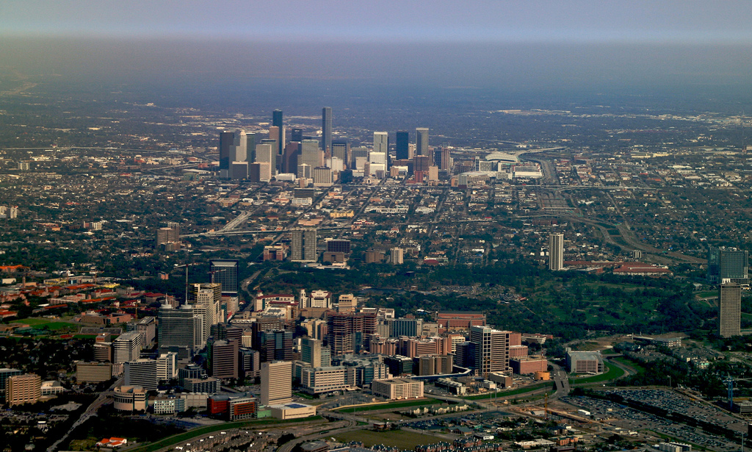
The Texas Medical Center is the largest medical center in the world

